Slide 1
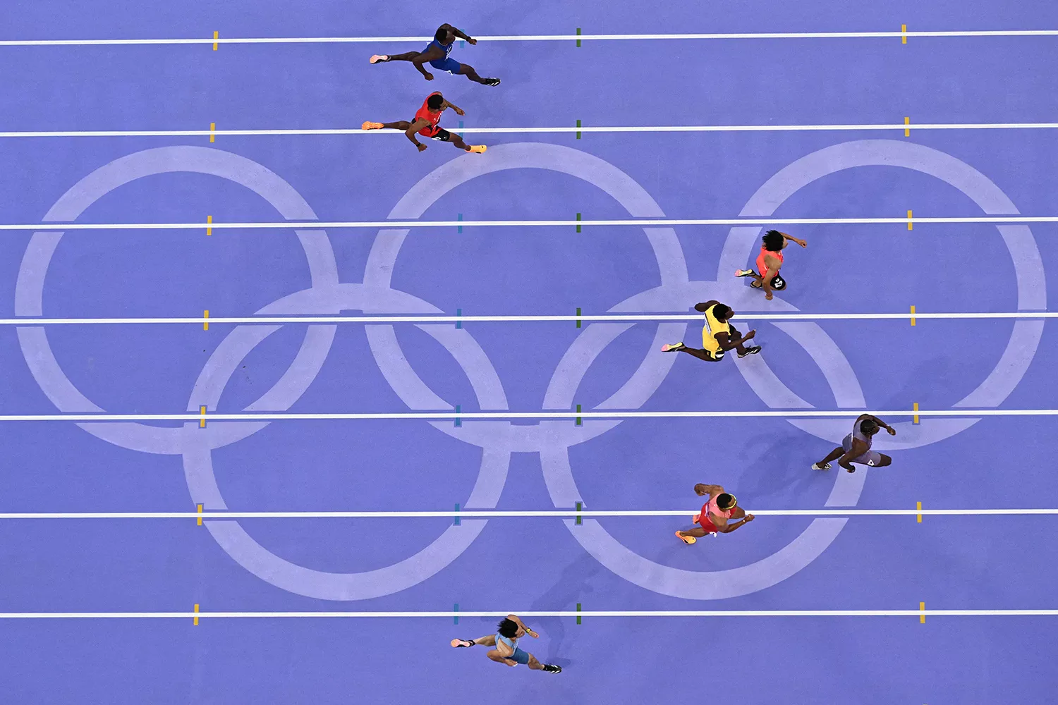
OLYMPICS
EVOLUTION IN
TRACK AND SWIMMING
By Daniel Abrego, Kim Crespo
Robert Odhiambo, Rudra Naik,
Noah Welgoss

Slide 2
Agenda
Introduction to our study (Noah)
References(Noah)
Data Cleaning/Data Limitations(Noah)
SQL Database/ERD (Robert)
Data Visualizations/Analysis(Kim/Rudra)
How to use Database(Daniel)
Ethical Considerations(Daniel)

Slide 3
Why the Olympics and objective
Our objective was conduct a comprehensive analysis of historical Olympic results by examining two distinct data sets to assess athlete performance improvements, growth in global presence, and overall country performance. The team aims to present data-driven insights on prevailing trends, including the evolution of team achievements, and to evaluate how countries' standings have shifted over time.

Slide 4
Reference
Data Sources:
Paris 2024 Olympic Summer Games
https://www.kaggle.com/datasets/piterfm/paris-2024-olympic-summer-games?resource=download
Olympic Summer & Winter Games, 1896-2022
https://www.kaggle.com/datasets/piterfm/olympic-games-medals-19862018?select=olympic_medals.csv

Slide 5
Data Cleaning/Data Limitations
Data Cleaning:
Python: Pandas, Janitor
Janitor Functionalities: clean_names, drop_duplicates, fillna, remove columns, rename columns
Function datetime.timedelta to calculate interval time for races
Data Limitations:
Historical recordings have estimations for some events
Not all of our events date back to 1896

Slide 6
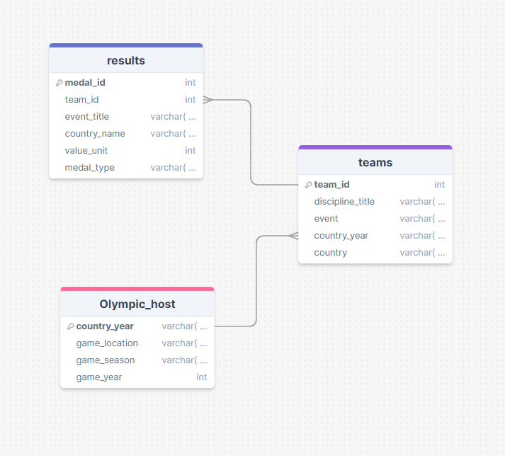
ERD for our database

Slide 7
Here is a look at our database.

Slide 8
Events We Chose
Track
Swimming
4x100m Relay Men
4x100m Freestyle Relay Men
4x100m Relay Women
4x100m Freestyle Relay Women
4x400m Relay Men
4x200m Freestyle Relay Men
4x400m Relay Women
4x200m Freestyle Relay Women

Slide 9
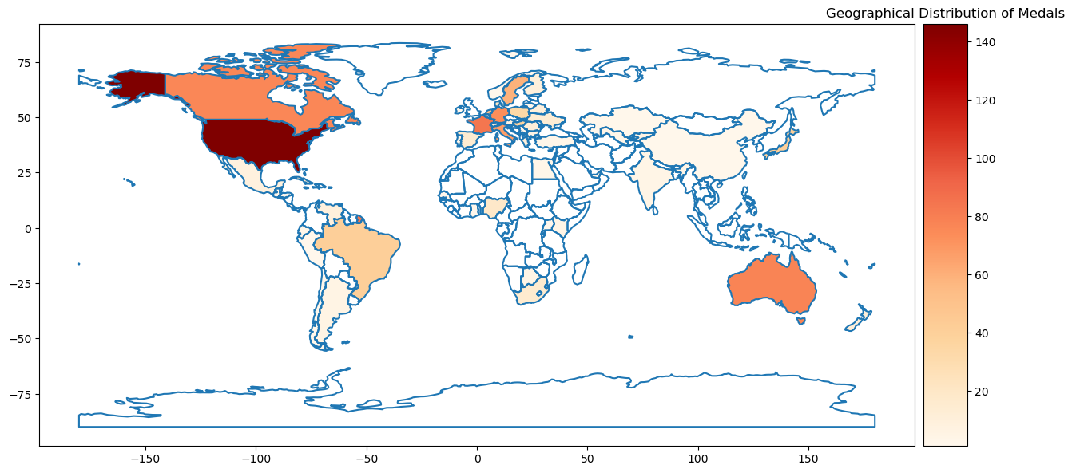
All Medals for Chosen Events
Notes:
We used sql academy and put into panda df

Slide 10
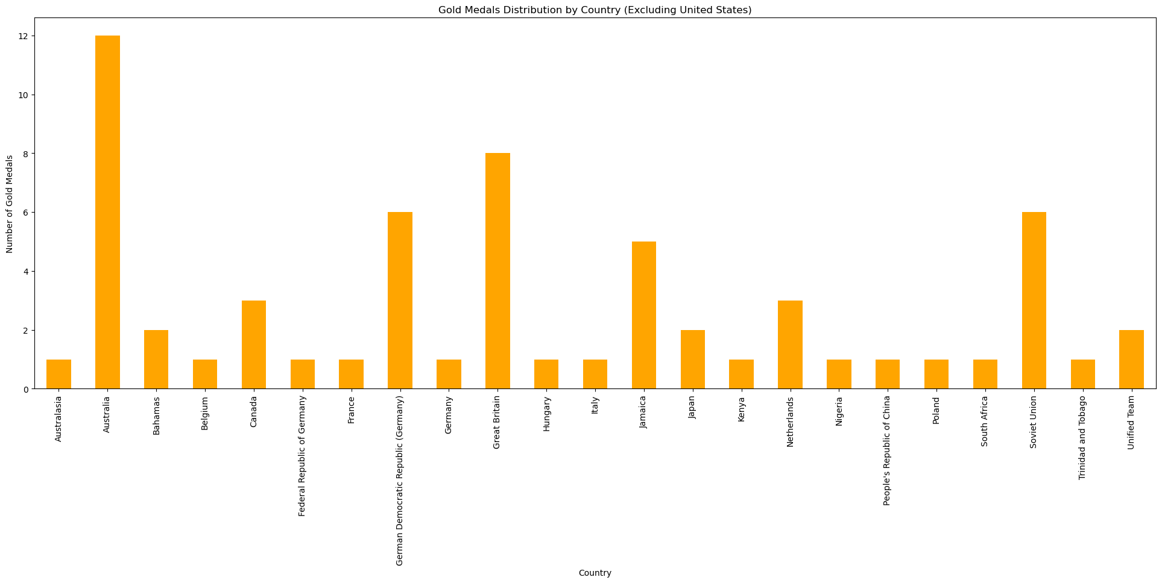
All Medals

Slide 11
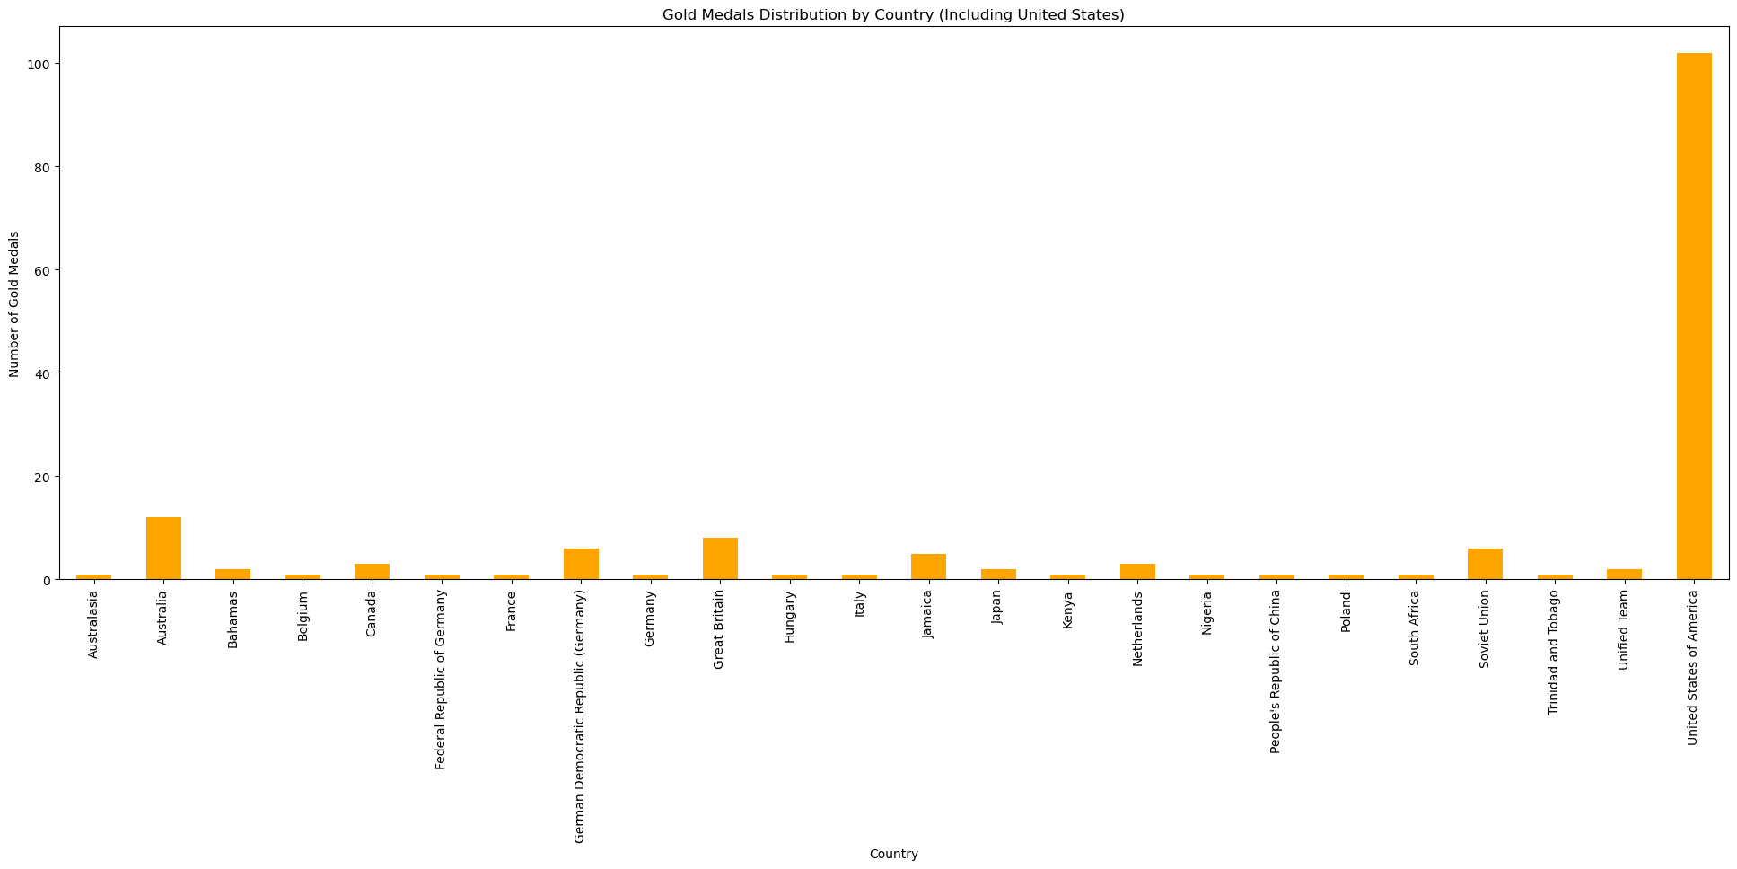
All Medals With USA

Slide 12
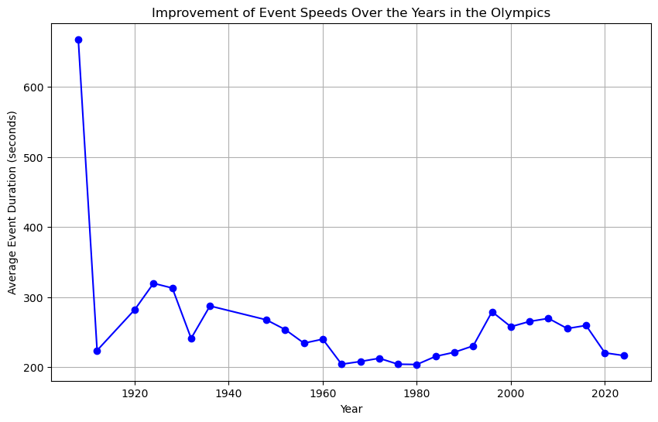

Slide 13
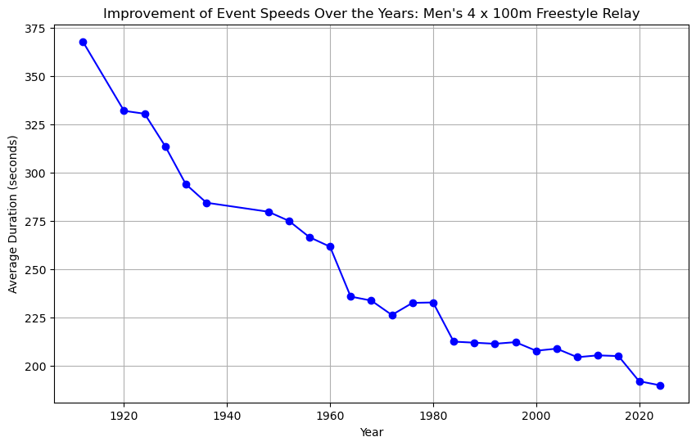
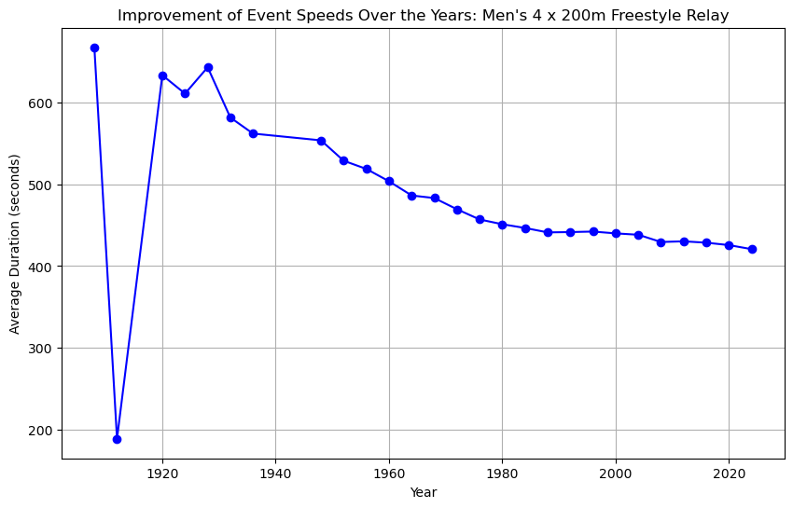
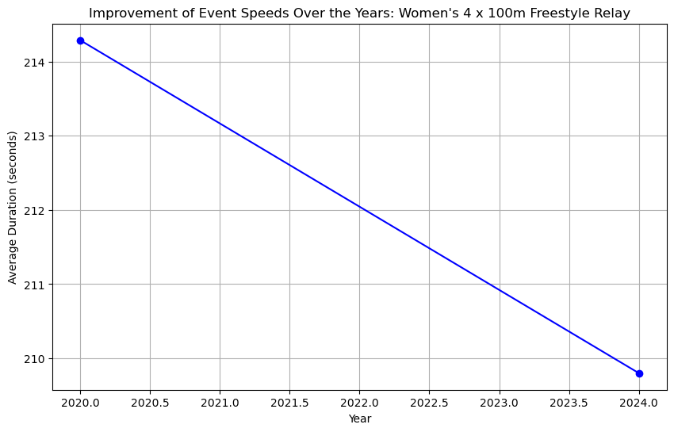
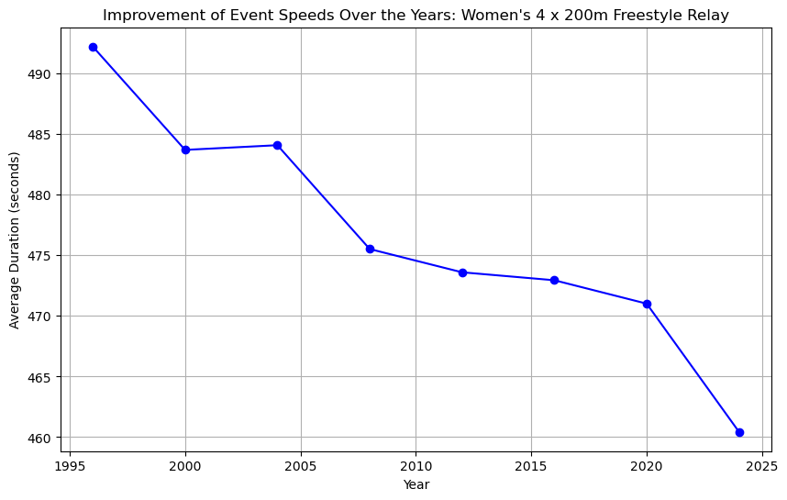
Swimming Events

Slide 14
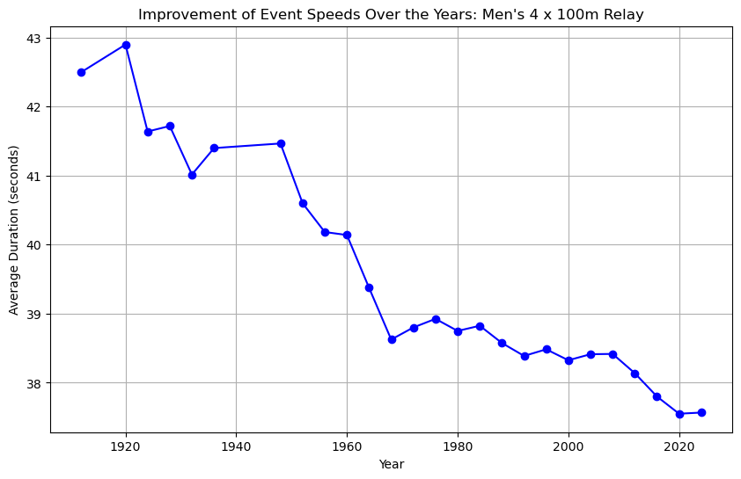
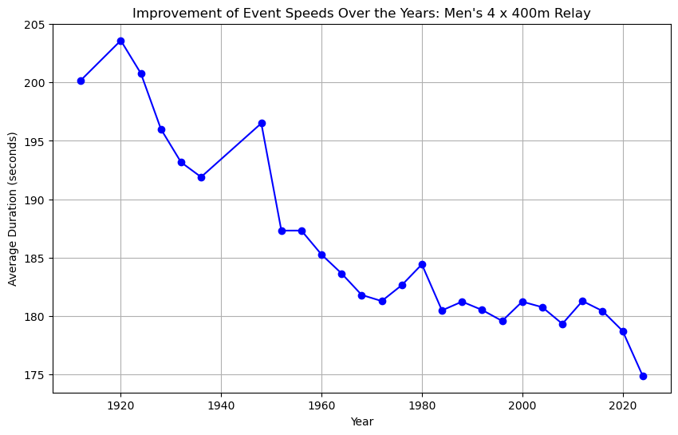
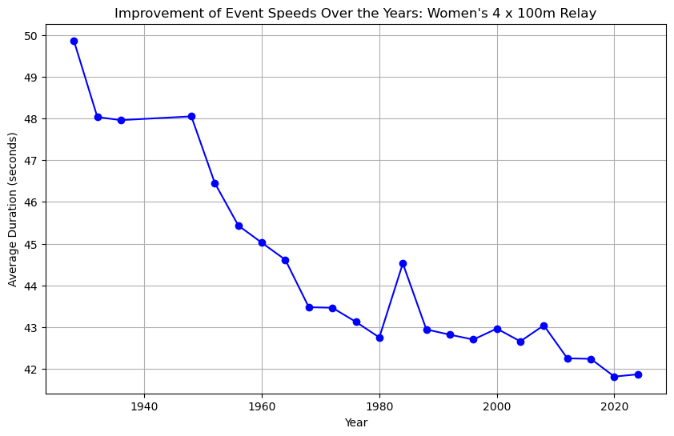
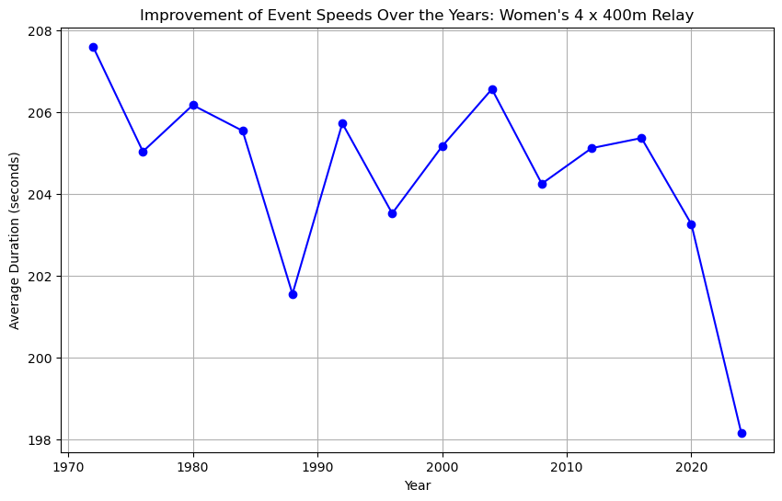
Track Events

Slide 15
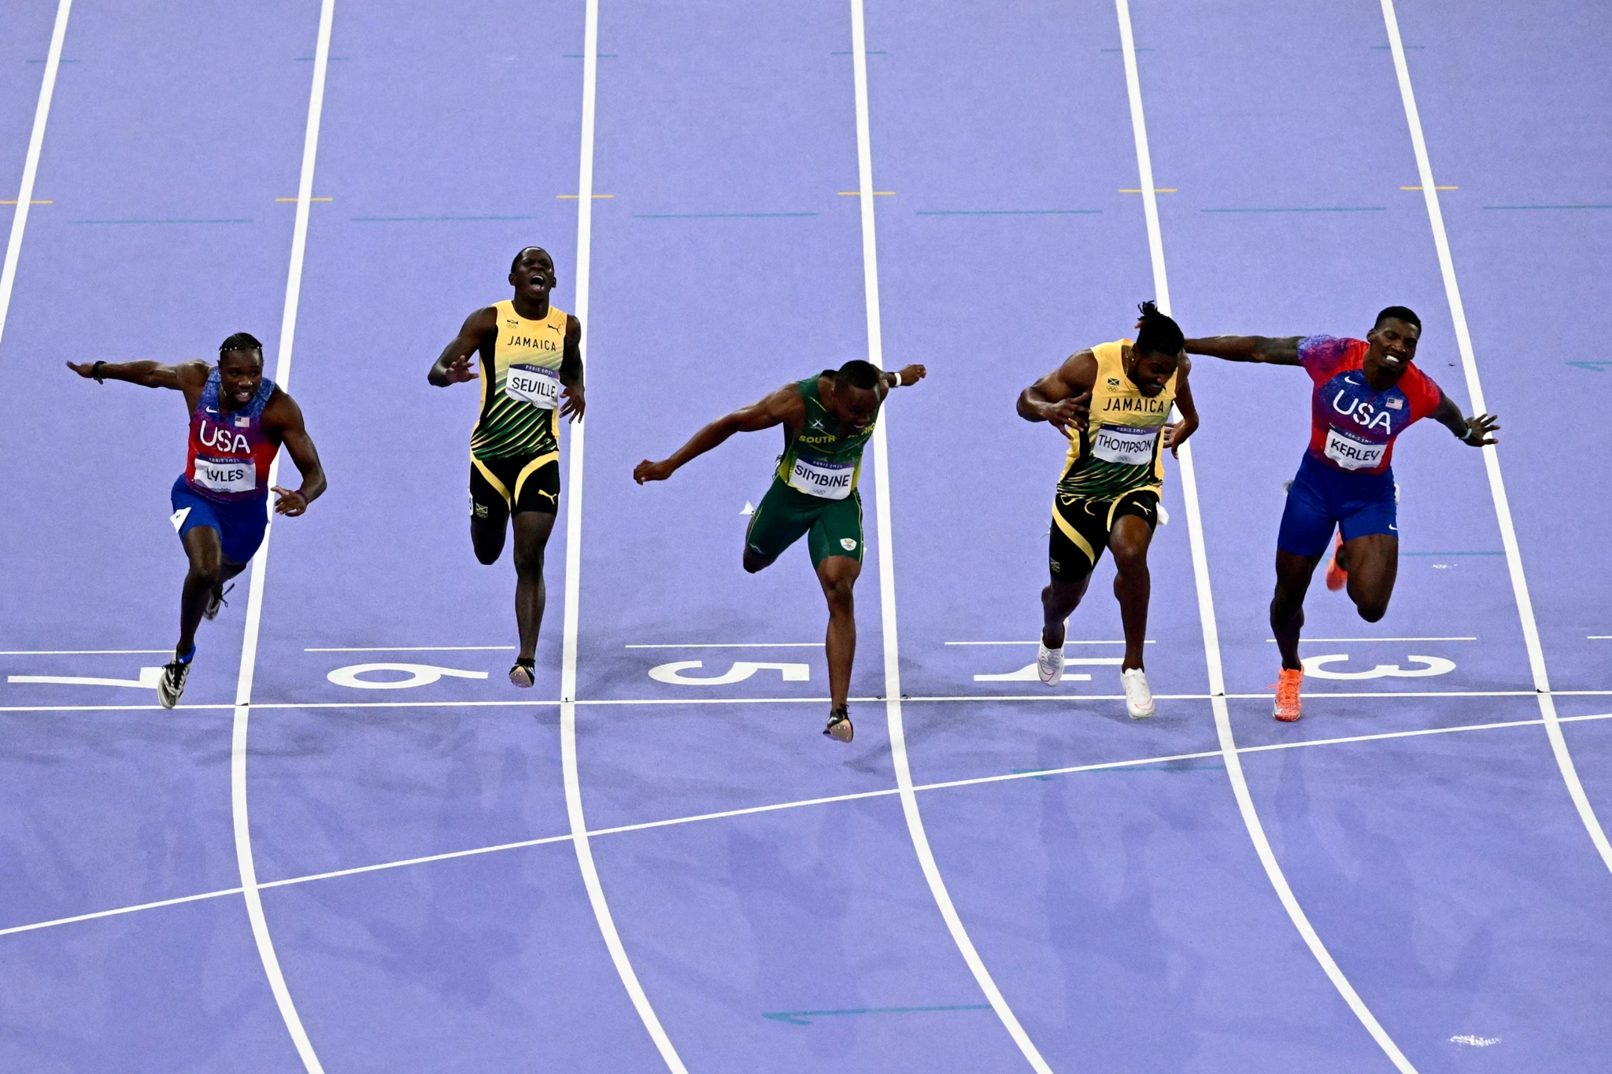

How to use/interact with DB
The intent of the database is to provide users with insights into country performance across selected Olympic events. It enables users to access historical results and evaluate overall performance by country. Additionally, users can examine individual events to analyze the criteria for achieving a top-three finish. While the data model does not forecast future performance, it allows for speculative analysis based on historical trends to infer the physical requirements necessary for success in upcoming events.

Slide 16
Ethical considerations
The datasets selected for our analysis pertain to Olympic results across various events for both men and women. Since participation in the Olympics is voluntary and results are publicly available, consent for data release is not required. The datasets include comprehensive results of all athletes, ensuring transparency and minimizing bias. Although some trends may reflect higher performance by certain countries, this is attributed solely to athletic performance rather than any data distortion. To uphold the integrity of the competition, all athletes are subject to monitoring under the International Olympic Committee’s (IOC) Anti-Doping Rules, which mandate both in-competition and out-of-competition testing to ensure compliance. Additionally, the IOC oversees the judging process for individual and team events, with judges appointed from international sports federations to prevent any national bias.
Given these stringent standards for performance and reporting, we are confident that the data analysis conducted is both valid and ethical.

Slide 17
Thank You

